Slide 1
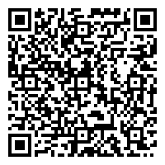
Need a safe place to talk?
16+
Visit Togetherall.com for FREE mental health support.
Did you know that as a student at Bucknell
Oorr scan herre tto jjoin Togettherralll ttoday..
University you have FREE access to a safe and anonymous online peer-to-peer community to get
support when you are feeling low?
Quick Explainer Video
Togetherall is easy to access & available 24/7.
Member testimonial video
On good days I can support others. On bad days, when I need supporting, I can find information to understand how to deal with it.
Get support. Take control. Feel better.
Notes:
Talking Points:
What is Togetherall? Togetherall is a clinically moderated, online peer-to-peer mental health community that empowers individuals to anonymously seek and provide support 24/7.
Who can access? Togetherall is FREE to ALL students. The online community is available and active 24/7/367 via a mobile-responsive website (www.togetherall.com)
What does Togetherall offer students?
Access to a safe, online global community where individuals remain anonymous to each other and can draw strength from others with similar lived experiences - (note Togetherall does not offer 1:1 counselling or therapy of any kind, nor is it intended to be a crisis line)
Peace of mind knowing the online community is monitored and moderated by registered mental health professionals (known as Wall Guides) who ensure students are kept safe and feel supported
Access to additional self-assessments, recommended resources , self-guided courses and creative tools to help members express and track how they are feeling
How to register? Visit www.togetherall.com and register using your student email address- it’s that easy!

